Slide 1
BBB

Slide 2
Inhoudsopgave
Intro
Maths
Model
Analysis
Phase-transistion &Bose-einstein

Slide 3
Research question
How does the degree distribution in the Bianconi-Barabasi model depend on the fitness distribution in the network?
Simultaneously, can we find the fitness distribution of real-world networks based on the time evolution of the degree of the nodes?
Finally, can we observe the phase transition where a finite fraction of the nodes is linked to a single node?

Slide 4
Hypothesis
The degree distribution will follow a power-law, precisely like the BA model, if the fitness distribution has a finite domain. The node with the highest fitness value will draw a lot of other nodes in the second instance if the fitness distribution has an unlimited domain, resulting in a situation winner takes all phenomenon. We will therefor find in the plots a powerlaw disitbution with the exponent comparable to __ (from analysis).
It is possible to recreate the fitness distribution based on the degree distribution of real-networks that were created in a Biaconni-Barabasi fashion.

Slide 5
Bianconi-Barabasi Networks
What is it?
Preferential attachment
Fitness
Phase transitions
Maths

Slide 6
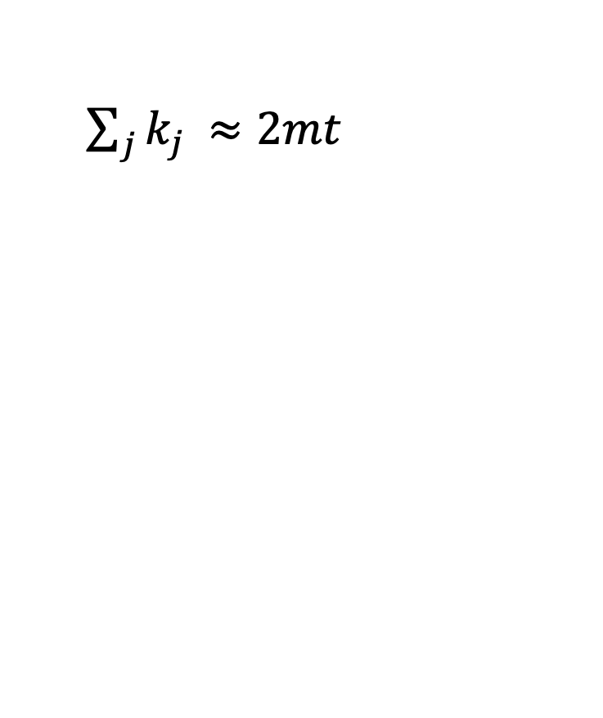
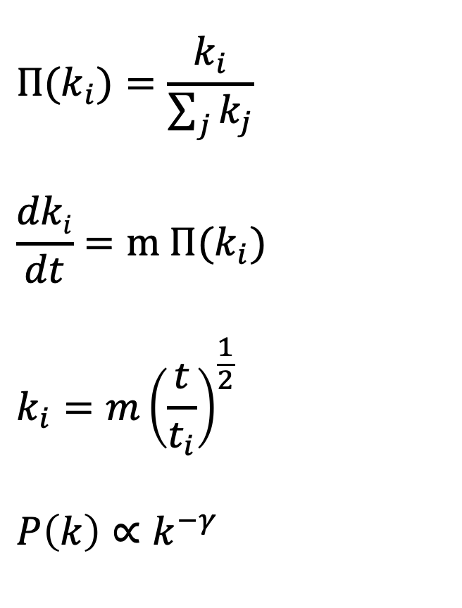
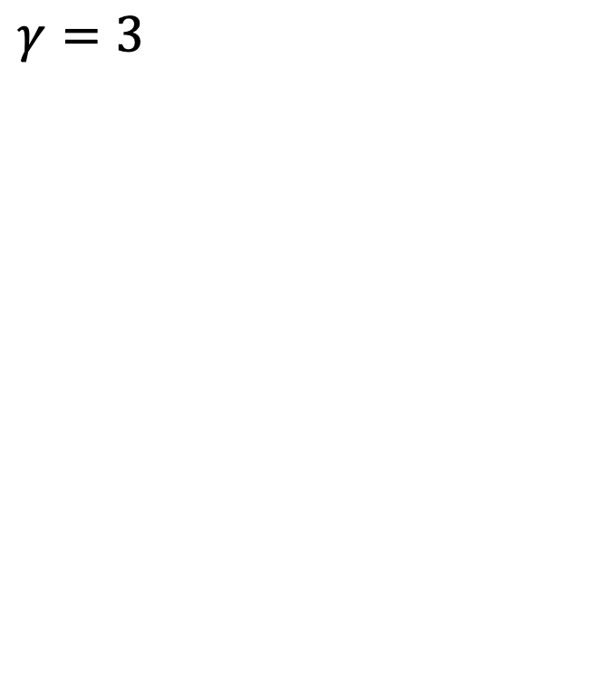
Theoretical overview: Barabasi-Albert
$${Π(k}_{i})=\frac{k_{i}}{\sum_{j}{k_{j}}}$$
$$\frac{dki}{dt}=m {Π(k}_{i})$$
$$k_{i}={m\left(\frac{t}{t_{i}}\right)}^{\frac{1}{2}}$$
$$P\left(k\right)∝k^{−γ}$$
$\sum_{j}{k_{j }≈2mt}$
$γ=3$

Slide 7
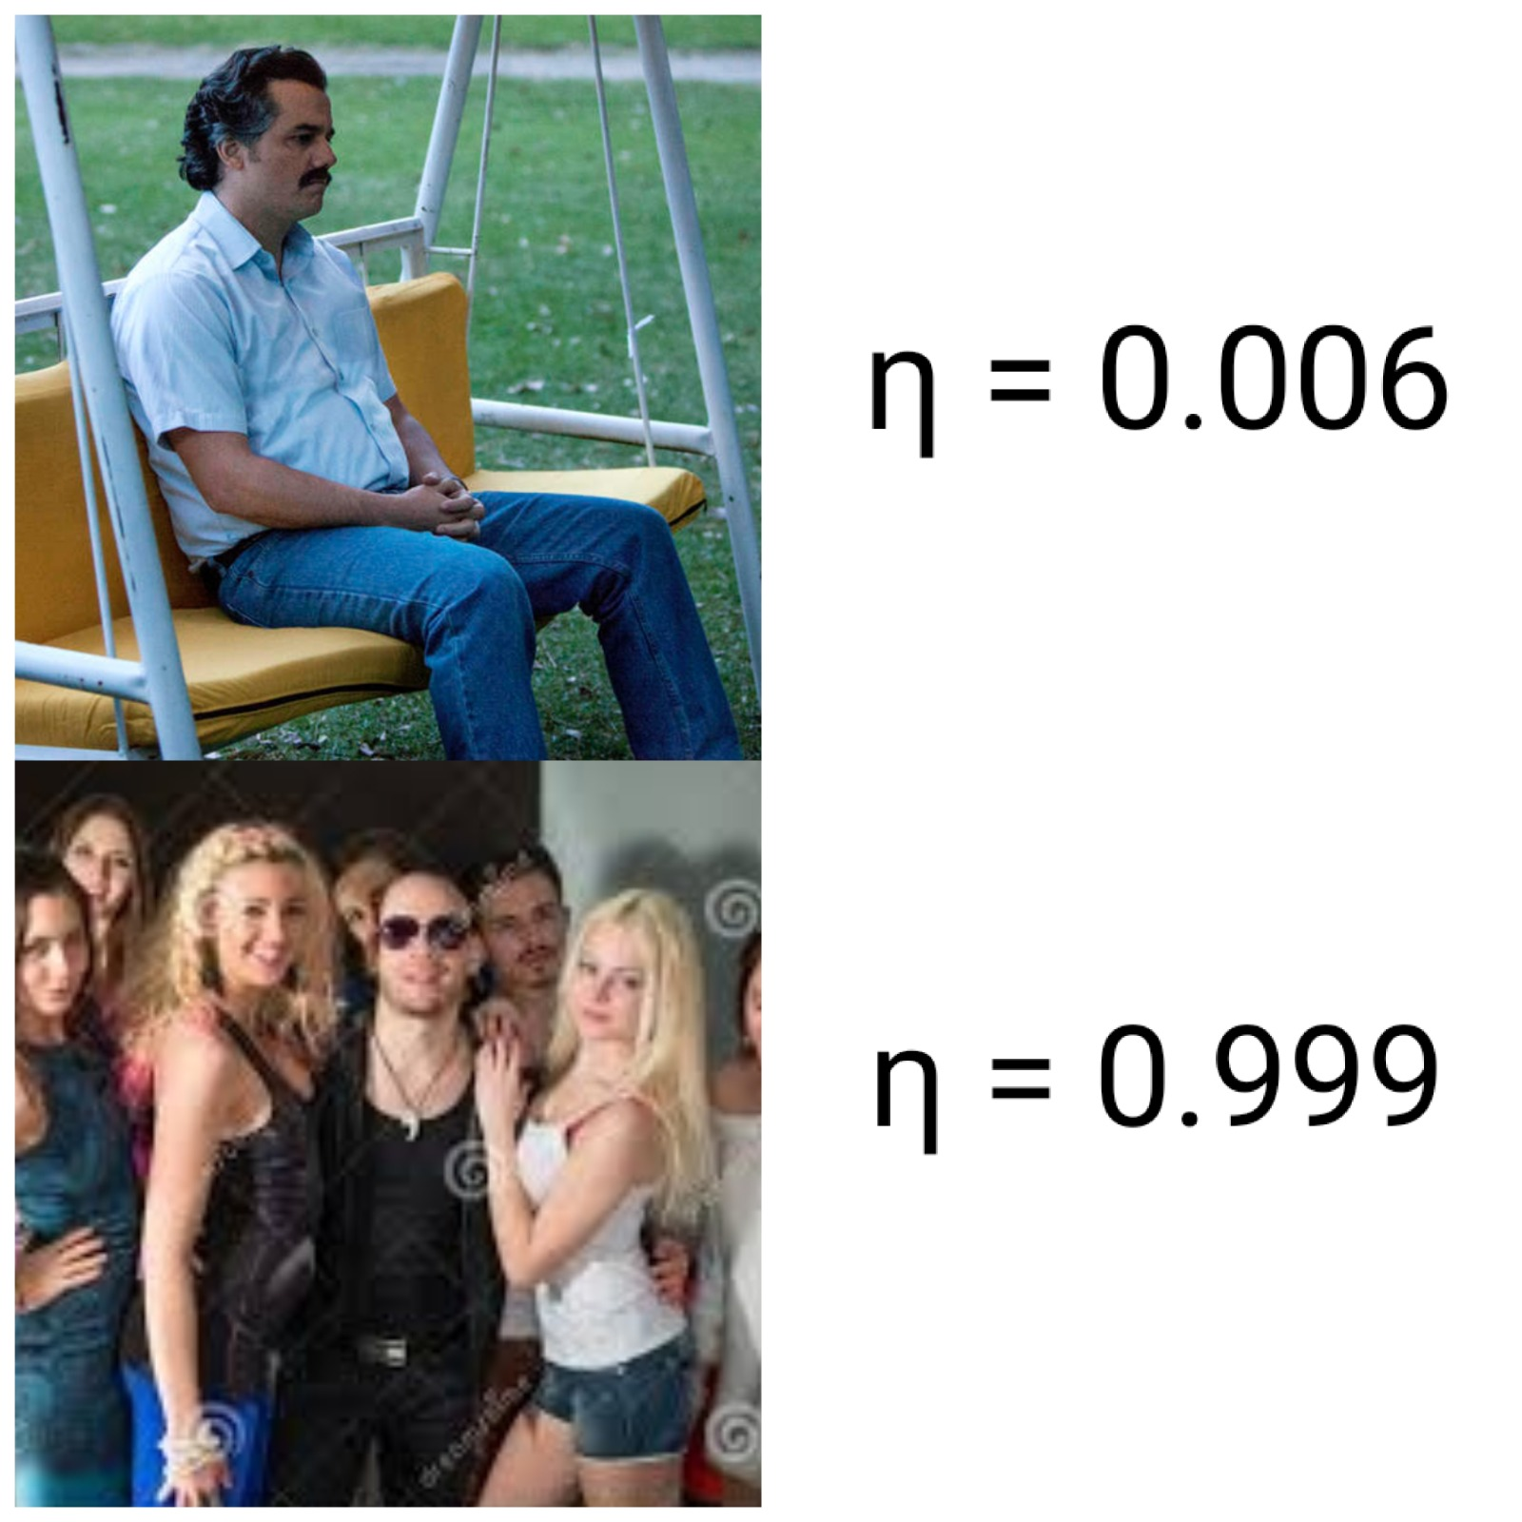
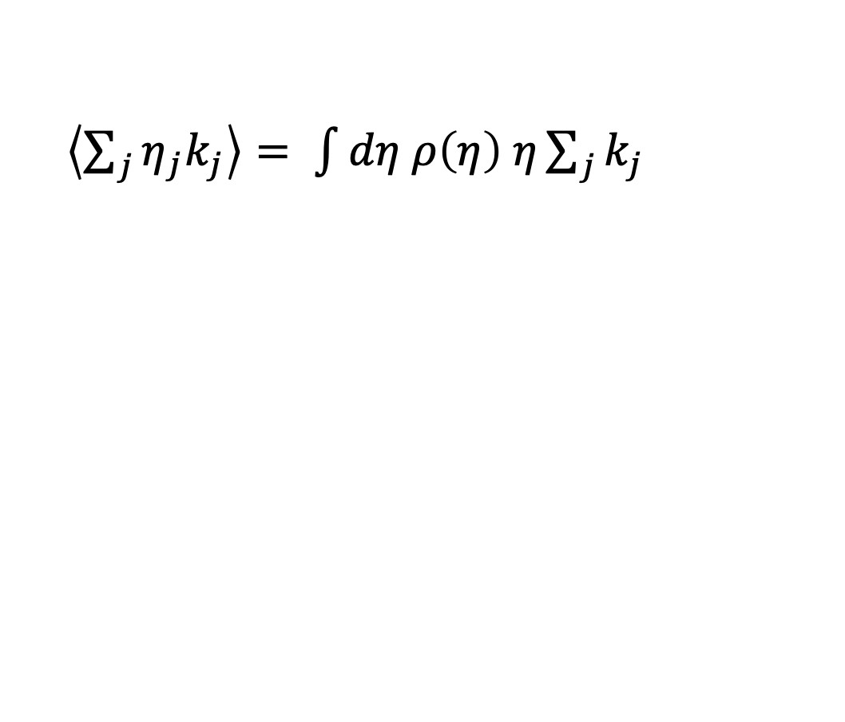
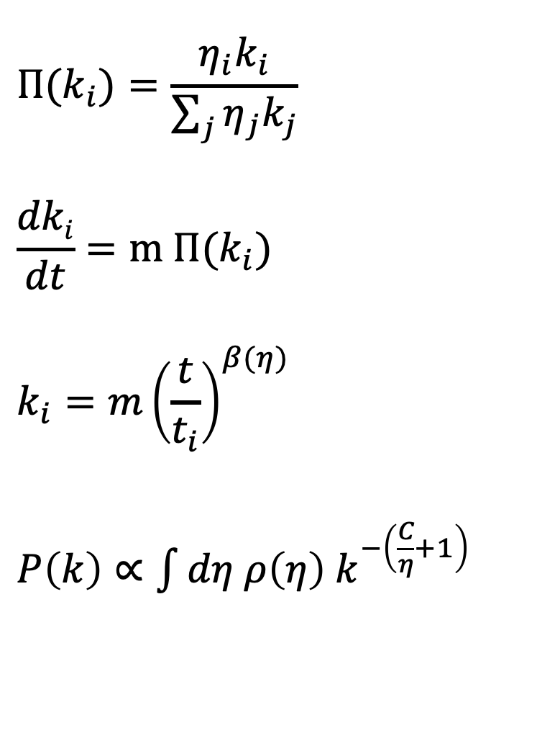
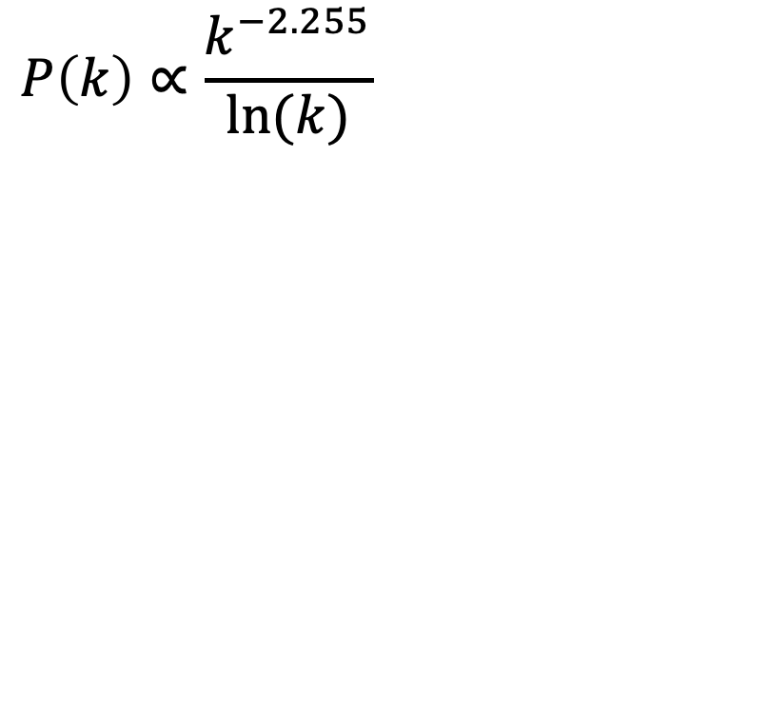
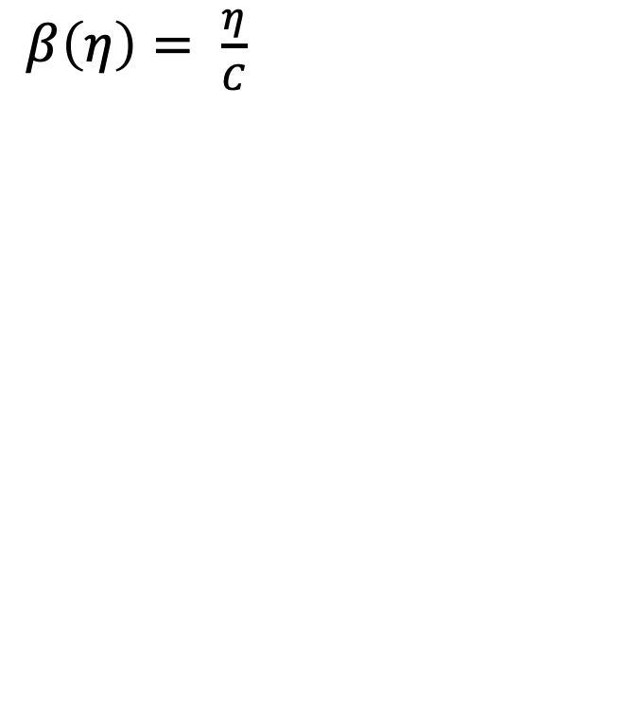
Theoretical overview: Bianconi-Barabasi
$${Π(k}_{i})=\frac{η_{i}k_{i}}{\sum_{j}{η_{j}k_{j}}}$$
$$\frac{dki}{dt}=m {Π(k}_{i})$$
$$k_{i}={m\left(\frac{t}{t_{i}}\right)}^{β(η)}$$
$P\left(k\right)∝\int{dη ρ\left(η\right) k^{−\left(\frac{C}{η}+1\right)}}$
$\left\langle \sum_{j}{η_{j}k_{j}}\right\rangle = \int{dη ρ\left(η\right) η\sum_{j}{k_{j}}}$
$β\left(η\right)= \frac{η}{C}$
$$P\left(k\right)∝\frac{k^{−2.255}}{ln⁡(k)}$$

Slide 8
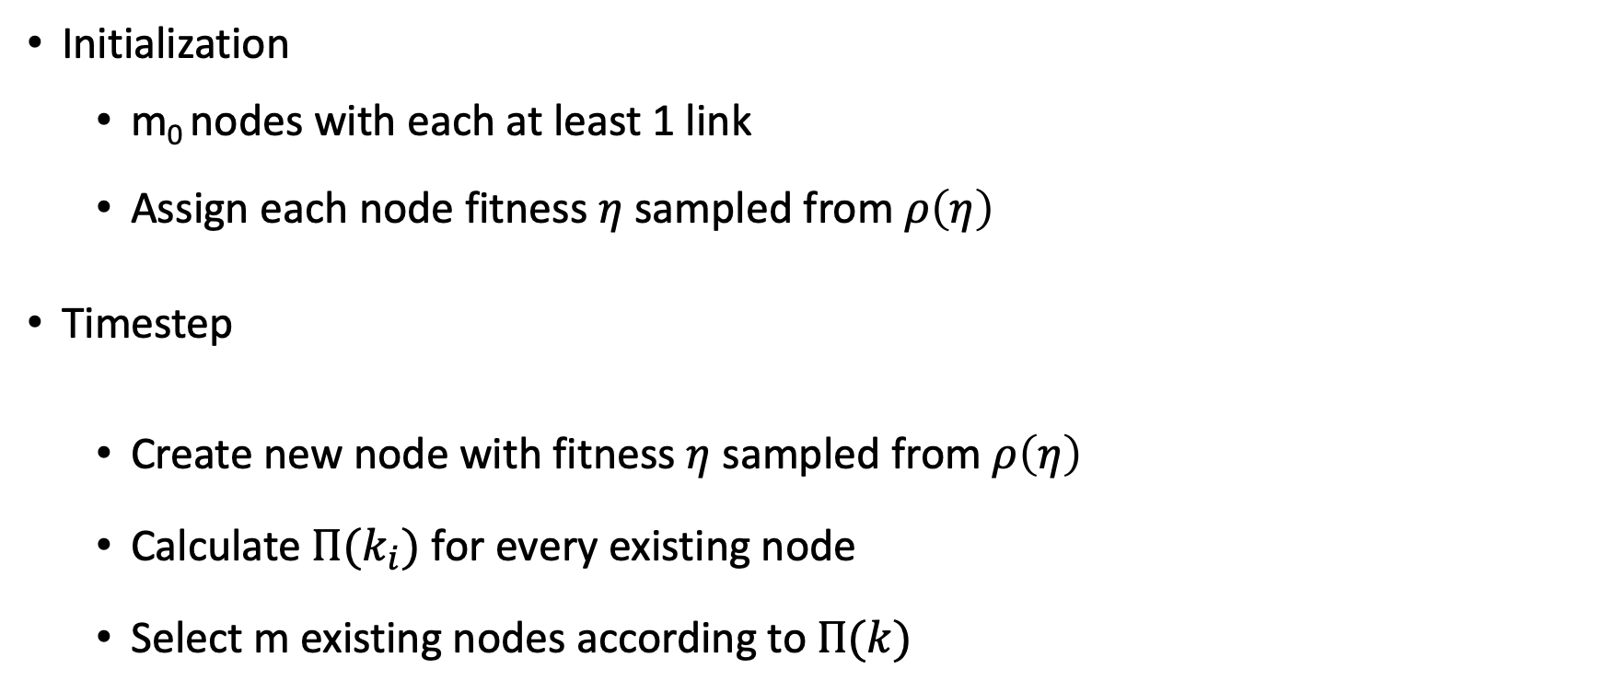
Model implementation
Initialization
m₀ nodes with each at least 1 link
Assign each node fitness $η$ sampled from $ρ\left(η\right)$
Timestep
Create new node with fitness $η$ sampled from $ρ\left(η\right)$
Calculate ${Π(k}_{i})$ for every existing node
Select m existing nodes according to$Π(k)$

Slide 9
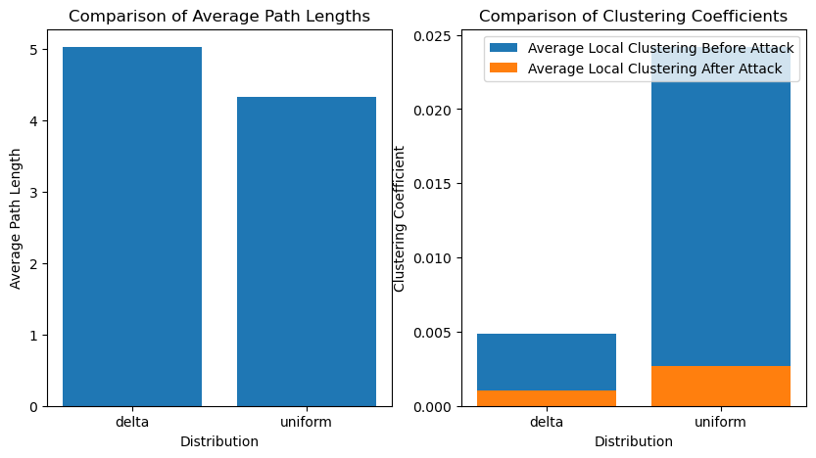
Network analysis
Analyze network:
Small work properties
Node overtaking
Robustness against attacks
 | Delta (BA-network) | Uniform (BB-network)
Degree assortativity | -0.0314 | -0.0737
Hubs | 0, 2, 9, 6, 4 | 5, 10, 1, 2, 4
Connected components before attack | 1 | 1
Connected components after attack | 15 | 169

Slide 10
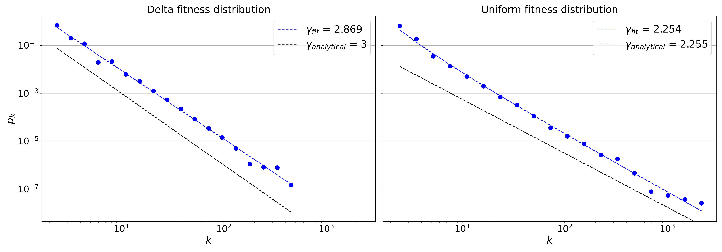
Analysis: Degree distributions

Slide 11
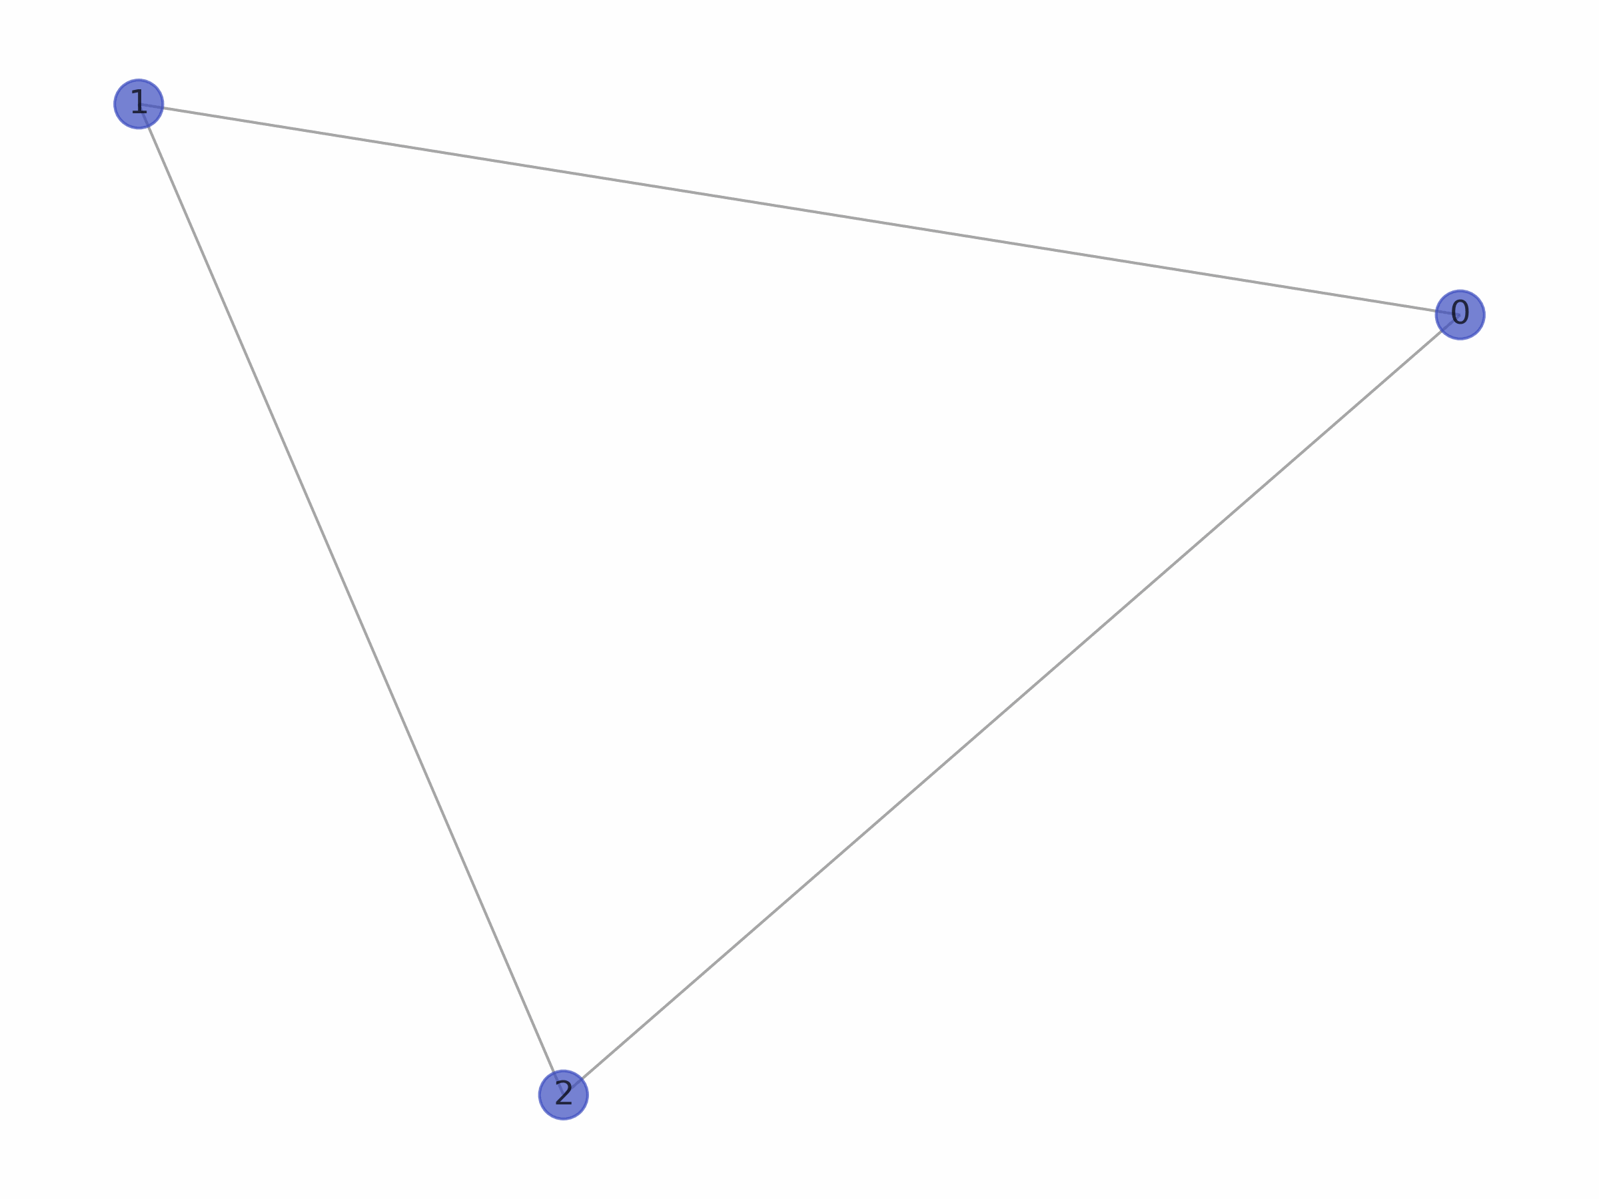
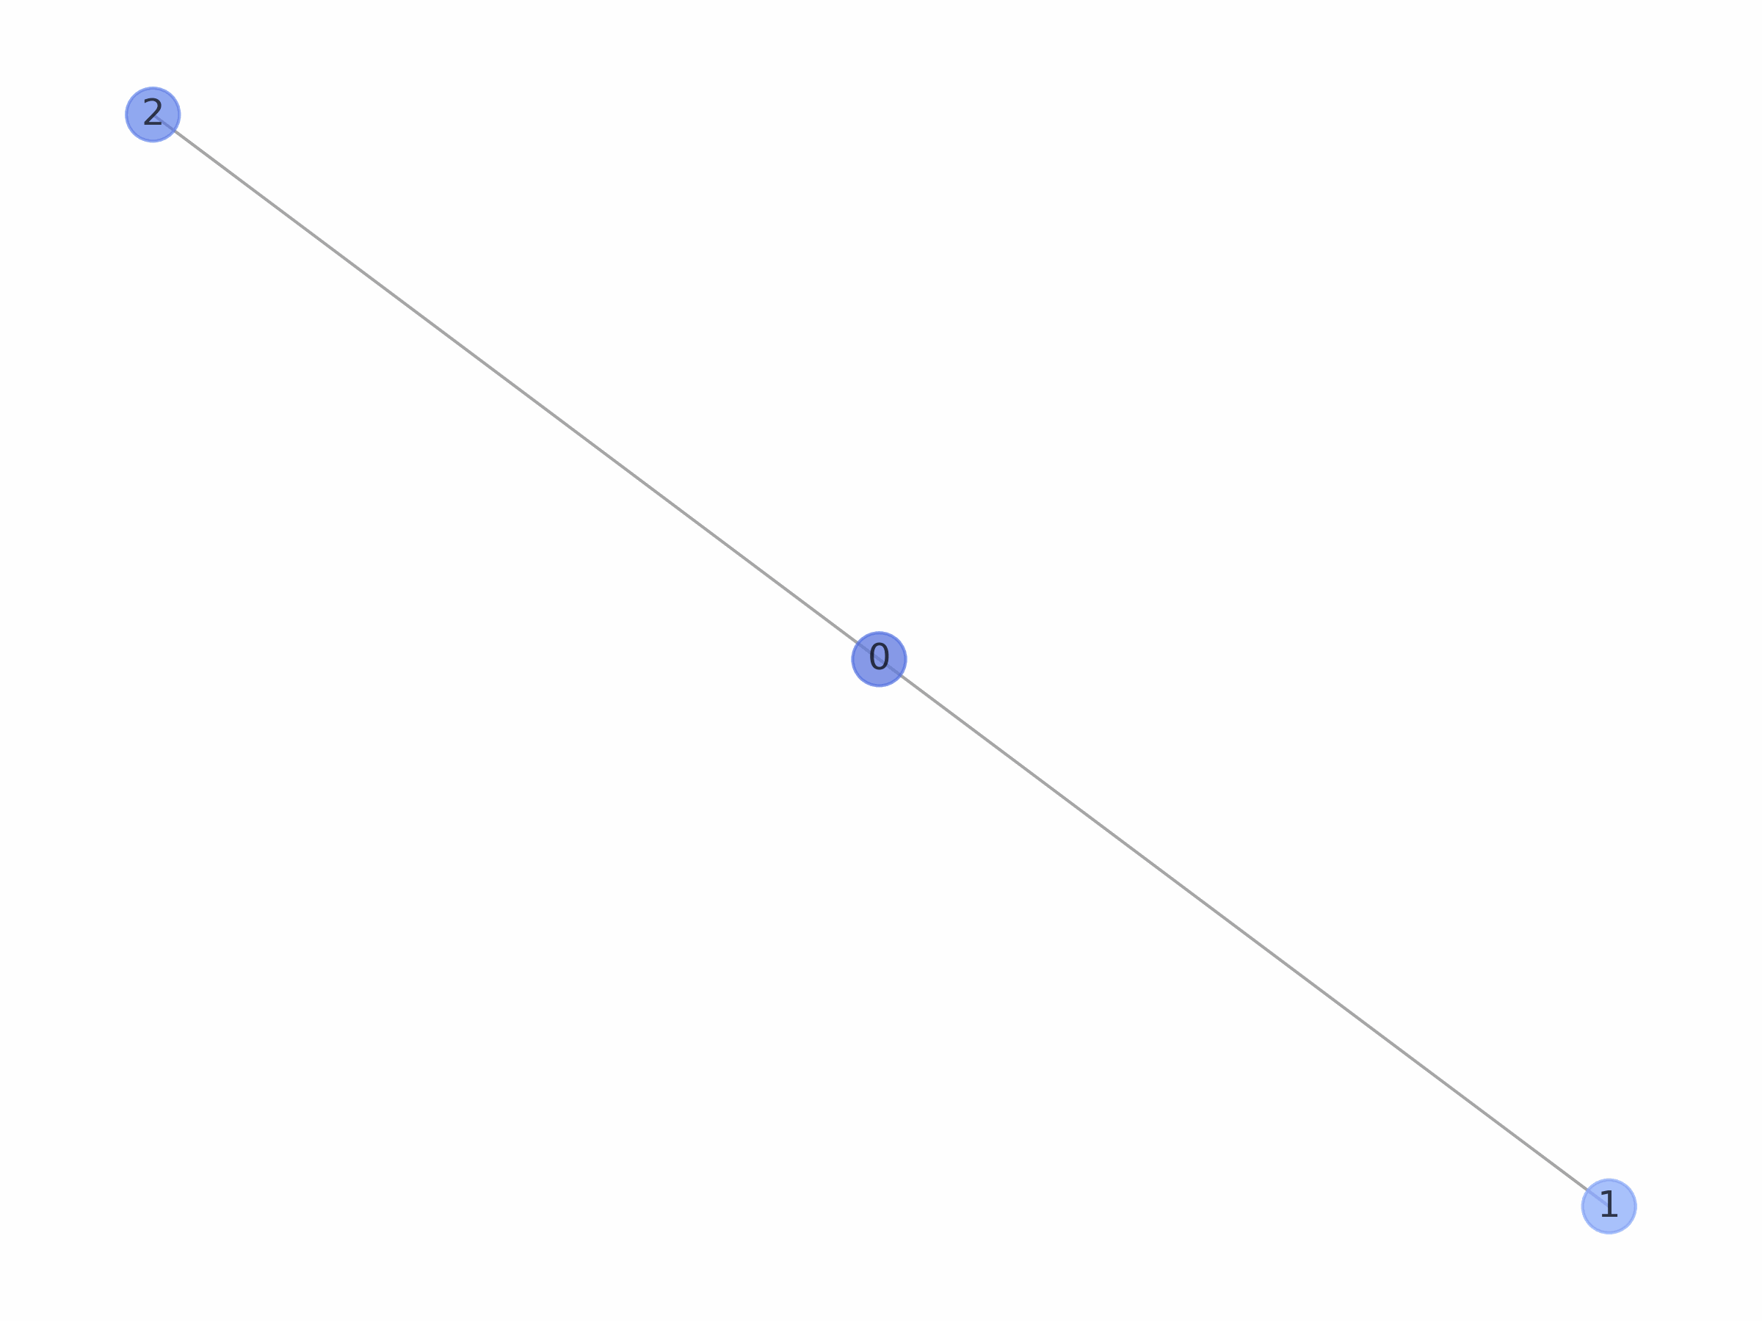
Analysis: Network visualization
Delta fitness distribution
Uniform fitness distribution

Slide 12
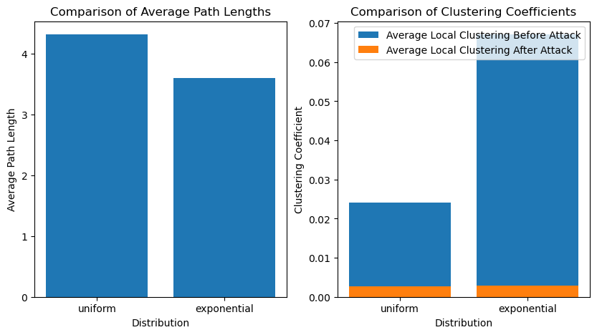
Network analysis
Analyze network:
Small work properties
Node overtaking
Robustness against attacks
 | Uniform (BB-network) | Exponential
Degree assortativity | -0.0737 | -0.3262
Hubs | 5, 10, 1, 2, 4 | 237, 72, 279, 144, 29
Connected components before attack | 1 | 1
Connected components after attack | 169 | 1239

Slide 13
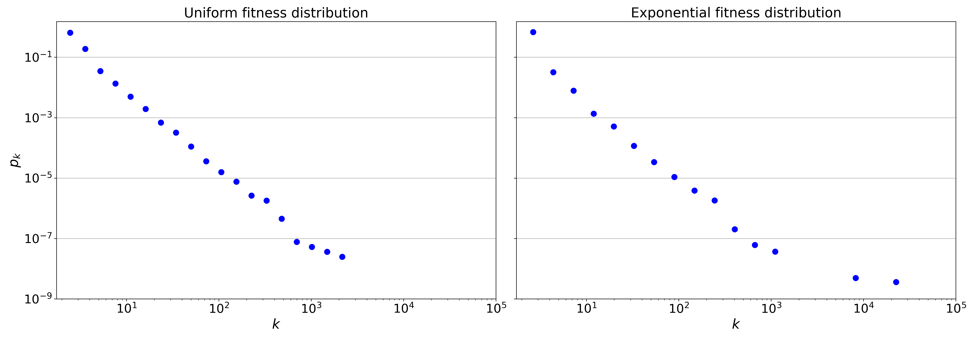
Analysis: Degree distributions

Slide 14
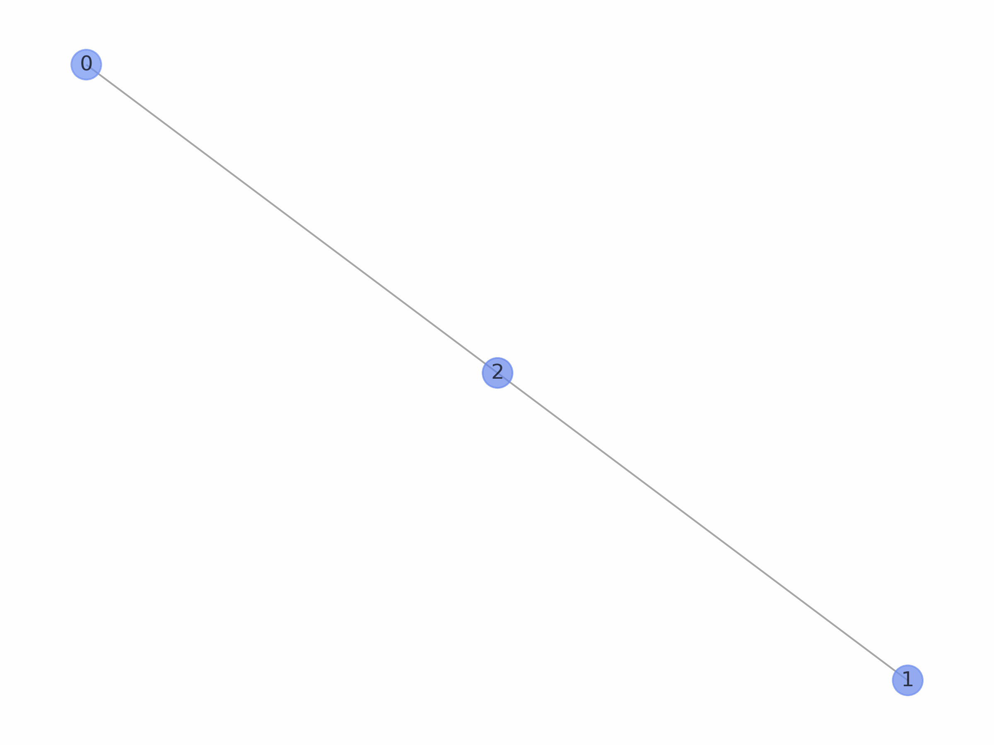
Analysis: Network visualization
Uniform fitness distribution
Exponential fitness distribution

Slide 15
Power law?
Power law vs. other distribution:
Not significant
Tuncated powerlaw?
Conclusions

Slide 16
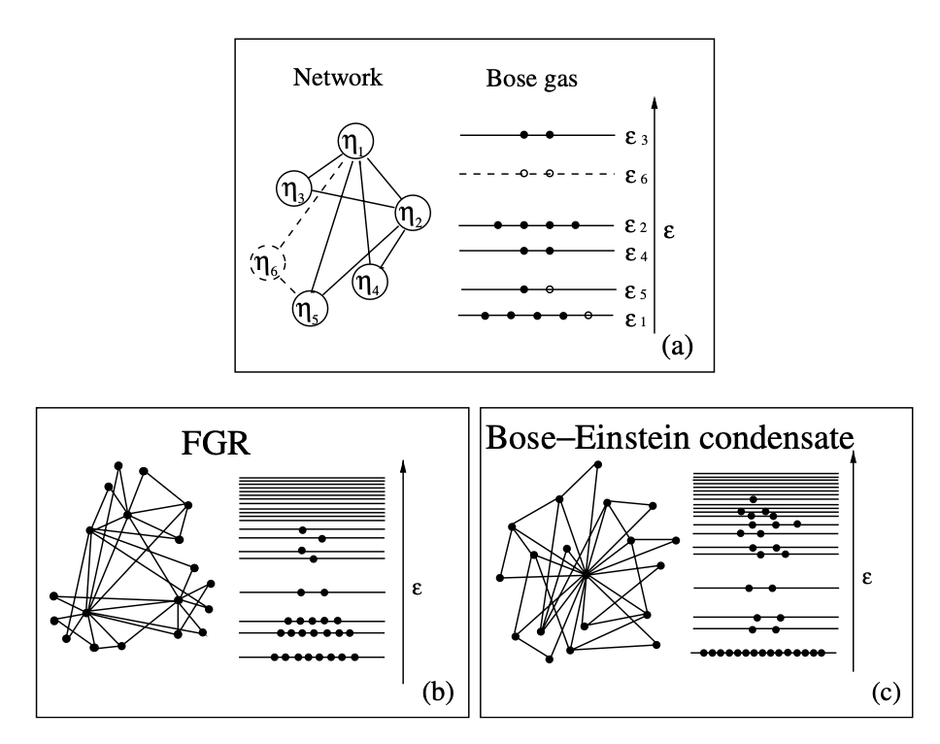
Phase transition: Bose-Einstein condensation
Bianconi, G., & Barabási, A. L. (2001). Bose-Einstein condensation in complex networks. Physical review letters, 86(24), 5632.

Slide 17
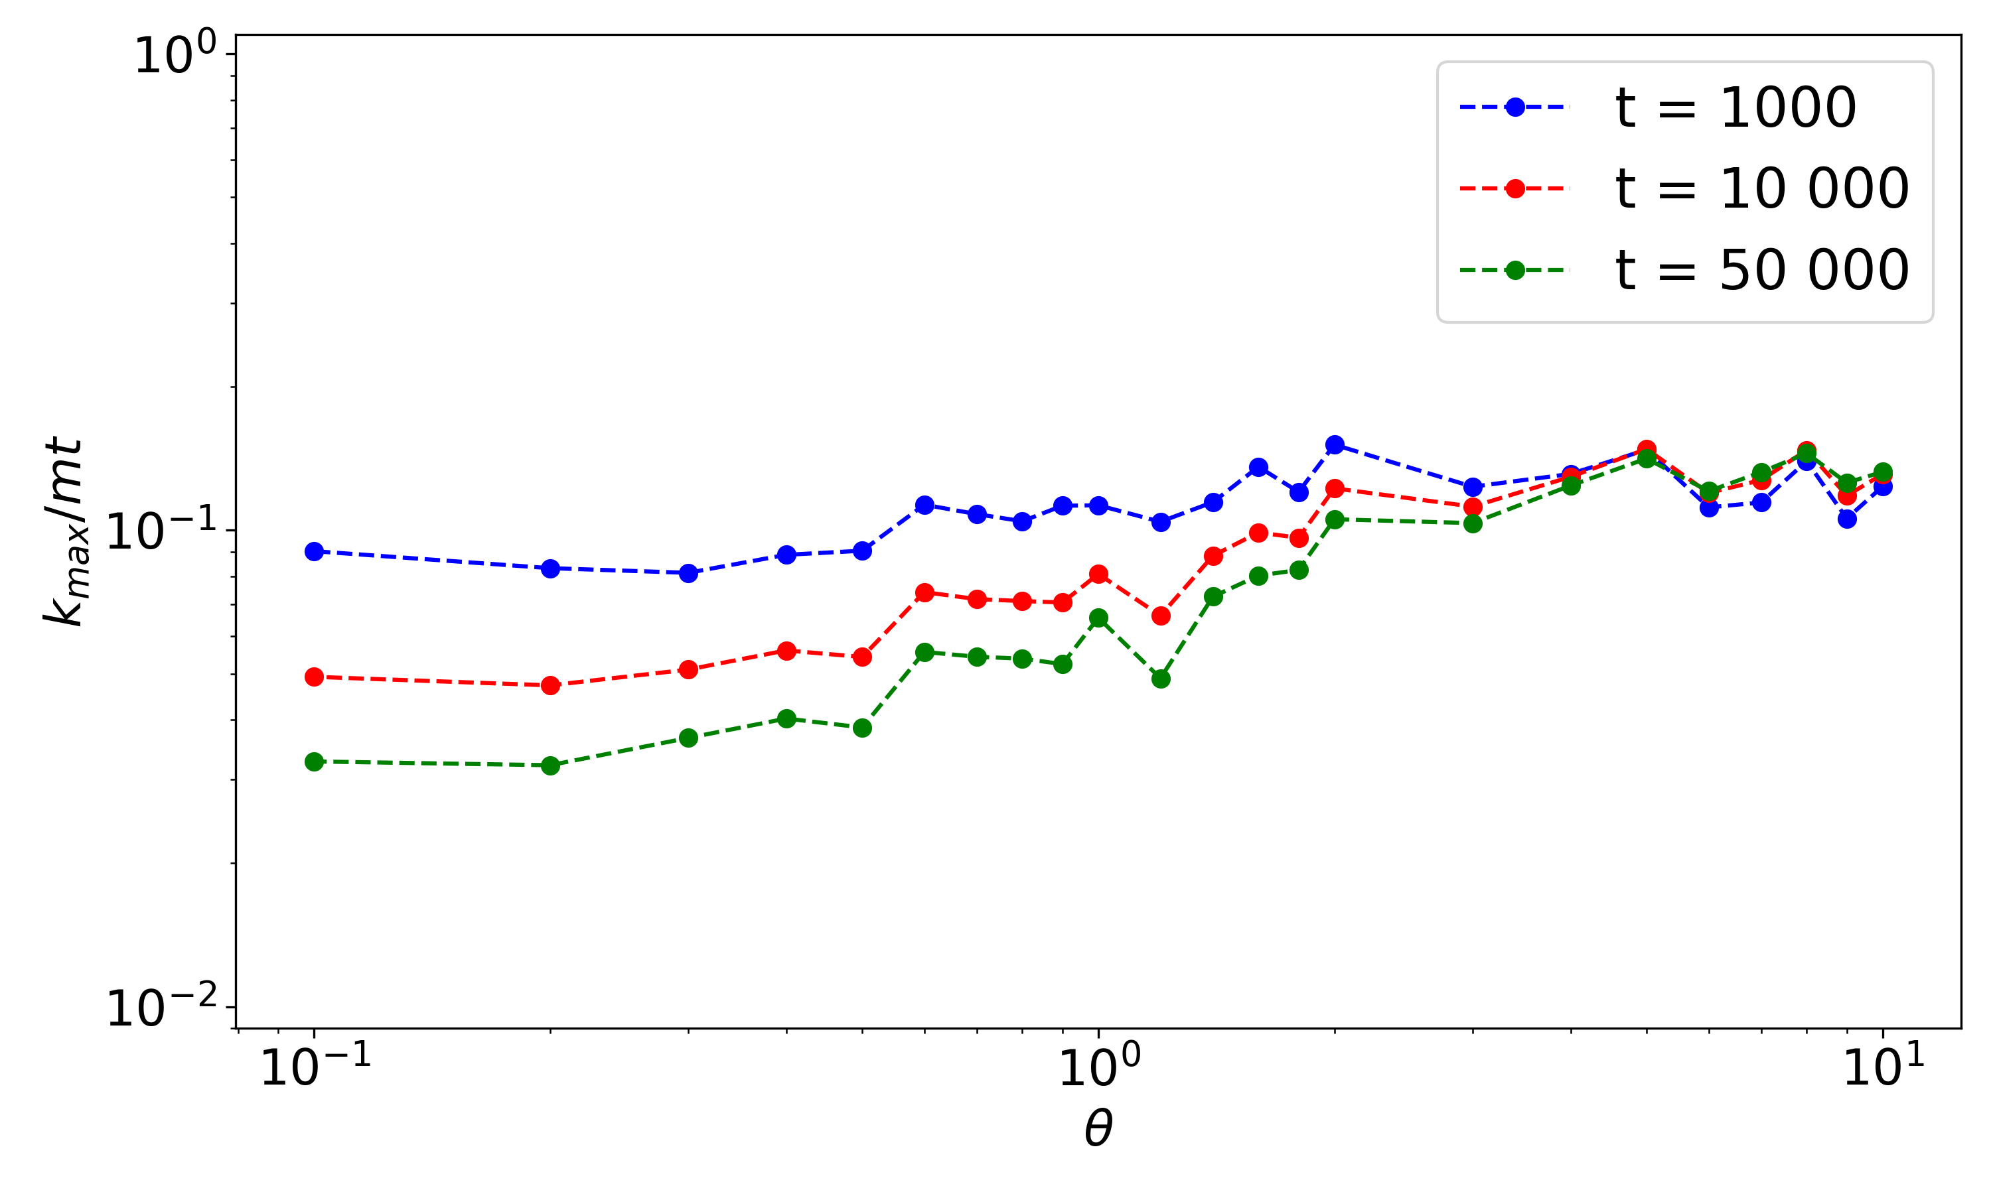
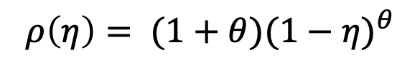
Phase transition: Bose-Einstein condensation
$$ρ\left(η\right)= (1+θ){(1−η)}^{θ}$$

Slide 18
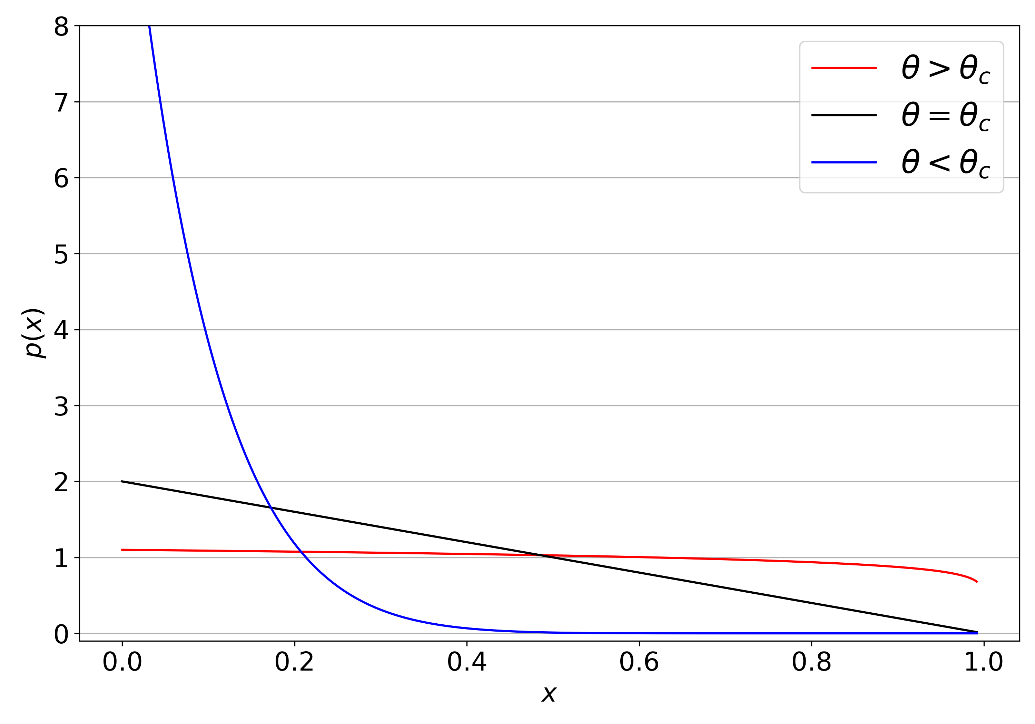
Phase transition: Bose-Einstein condensation

Slide 19
Real data

Slide 20
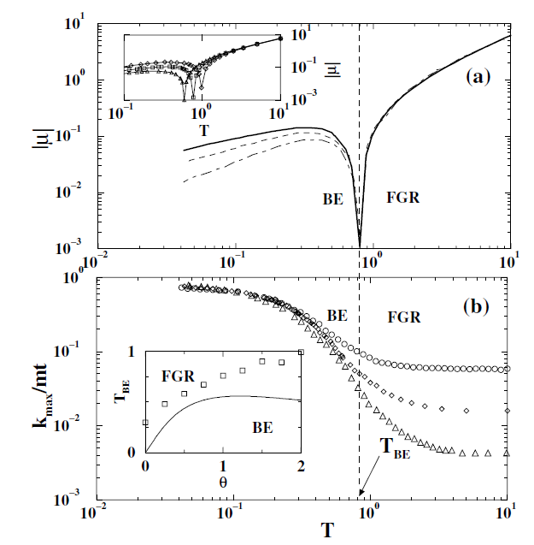
Phase transition

Slide 21
Conclusions

Slide 22
Questions

